Slide 1
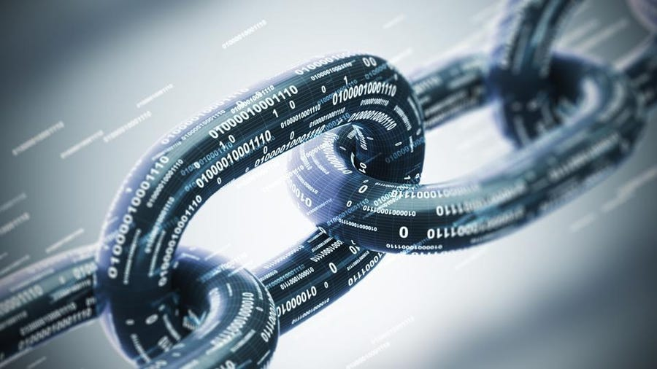
Introducing Blockchain, NFTs, DAOs, etc.
Getty

Slide 2
Agenda
Learn what blockchain is and appreciate its overall importance,
Understand how cryptocurrencies record transactions using blockchain technology,
Highlight innovative blockchain applications that are transforming society, and
Discuss how libraries can use blockchain and cryptocurrencies to enhance their value.

Slide 3
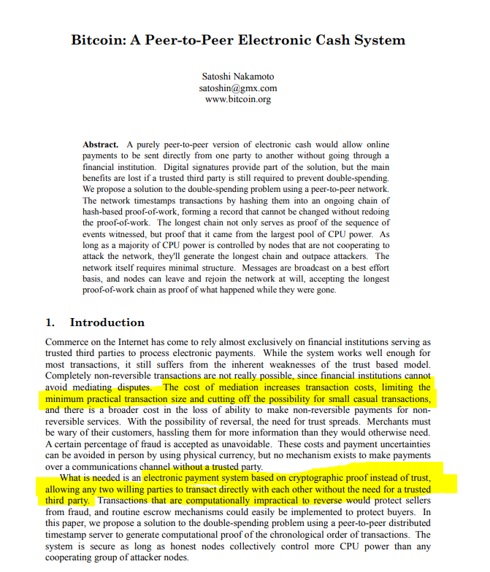
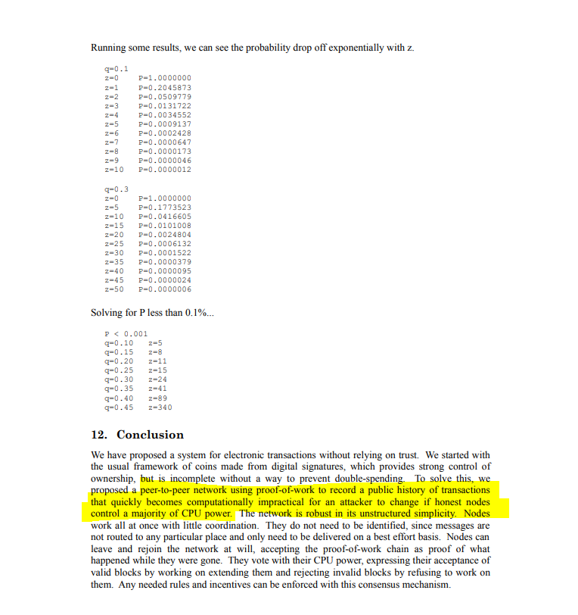
Nakamoto’s Bitcoin White Paper

Slide 4
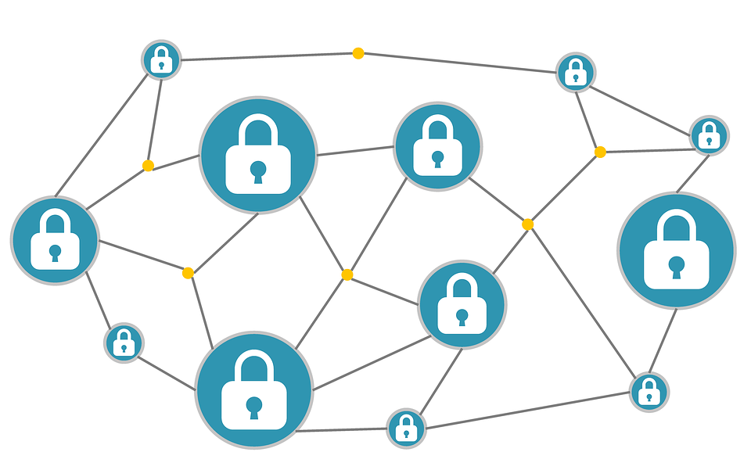
Blockchain is the database (i.e., an organized collection of data stored/accessed electronically) that stores cryptocurrencies and other applications. It distributes identical copies of the database across an entire network, so it is very difficult to hack or cheat the system.

Slide 5
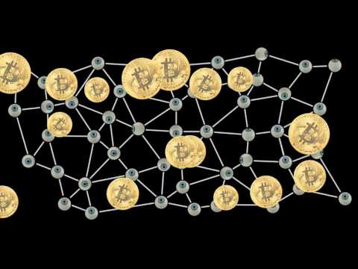
What is Blockchain?

Slide 6
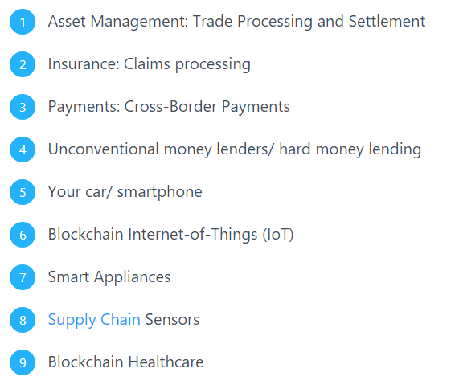
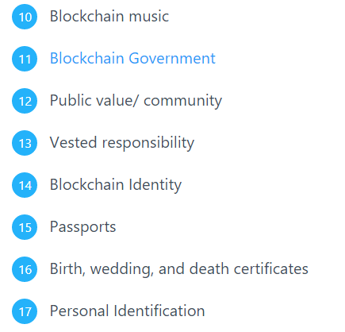
17 Uses of Blockchain Applications That Are Transforming Society
Source

Slide 7
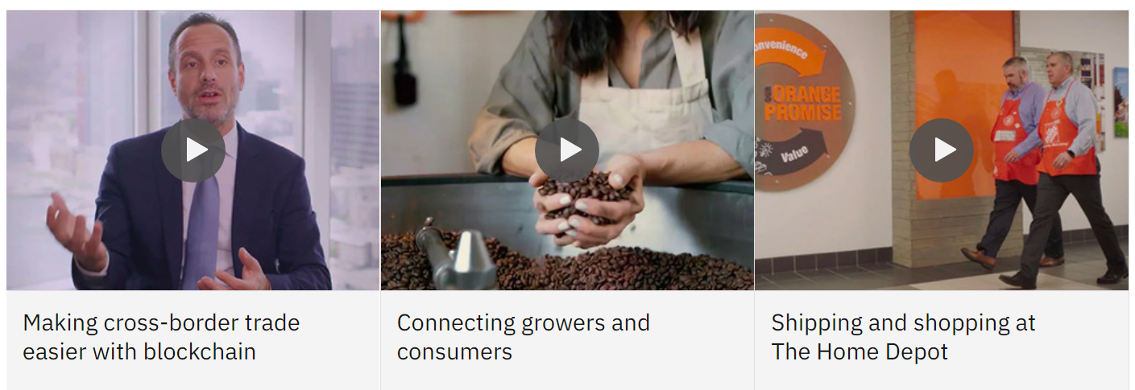
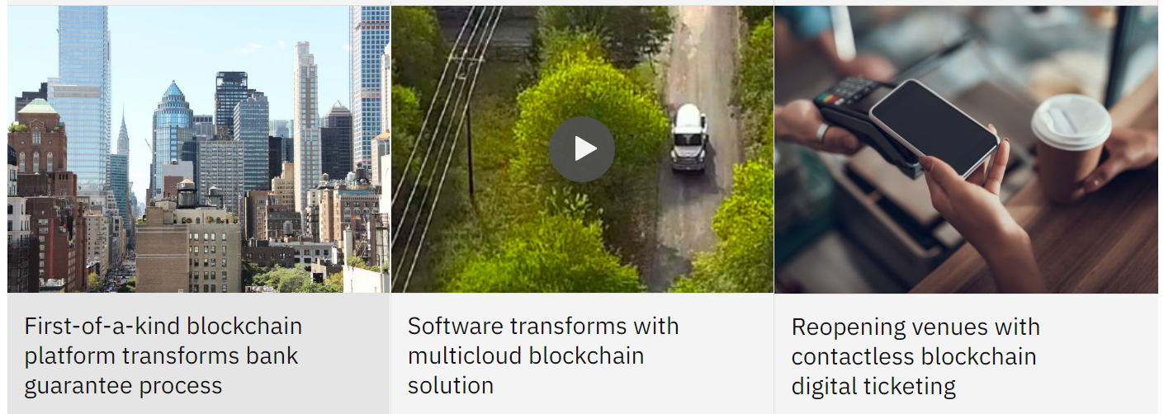
IBM’s Hyperledger Fabric: a distributed ledger with advanced privacy controls so only the data you want shared gets shared.
https://www.ibm.com/topics/hyperledger

Slide 8
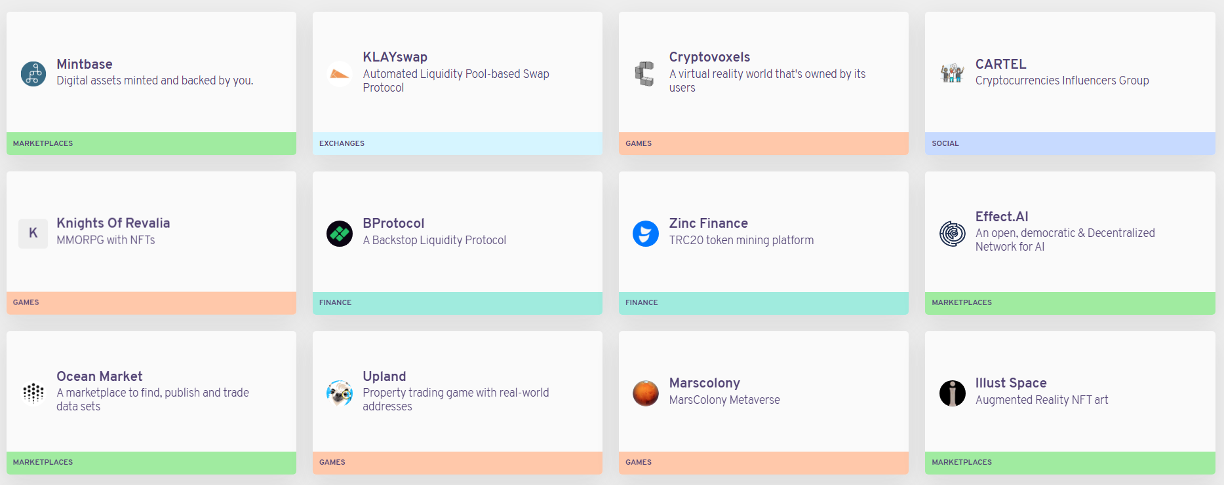
Decentralized Applications, DApps
https://www.stateofthedapps.com

Slide 9
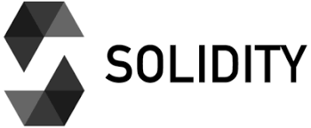
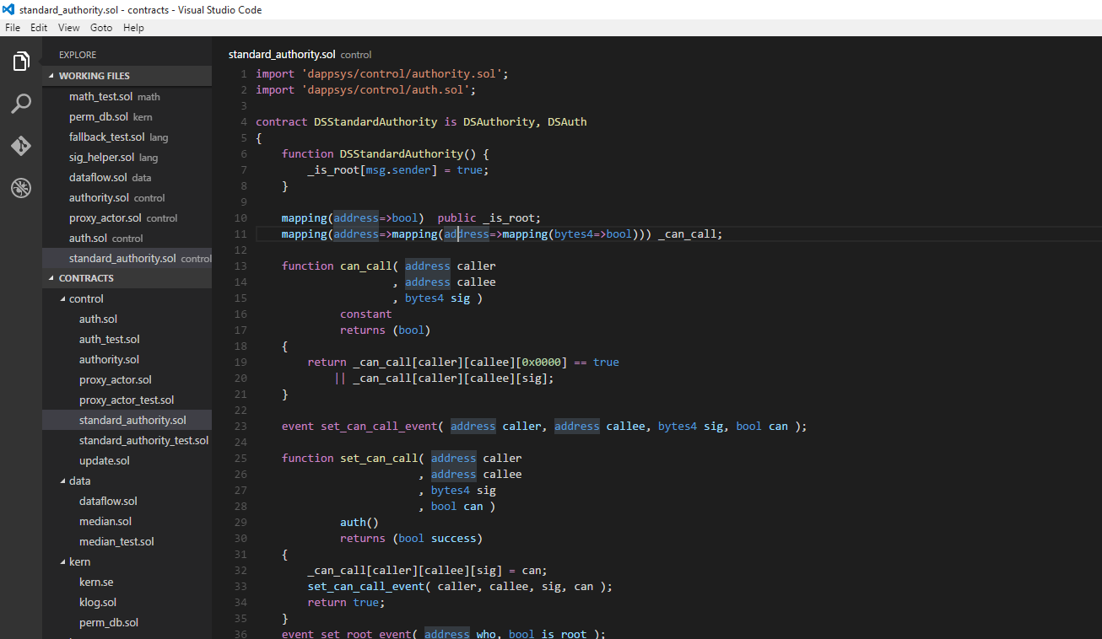
is an object-oriented, high-level language for implementing smart contracts for uses such as voting, crowdfunding, blind auctions, and multi-signature wallets..
https://soliditylang.org
https://remix.ethereum.org

Slide 10
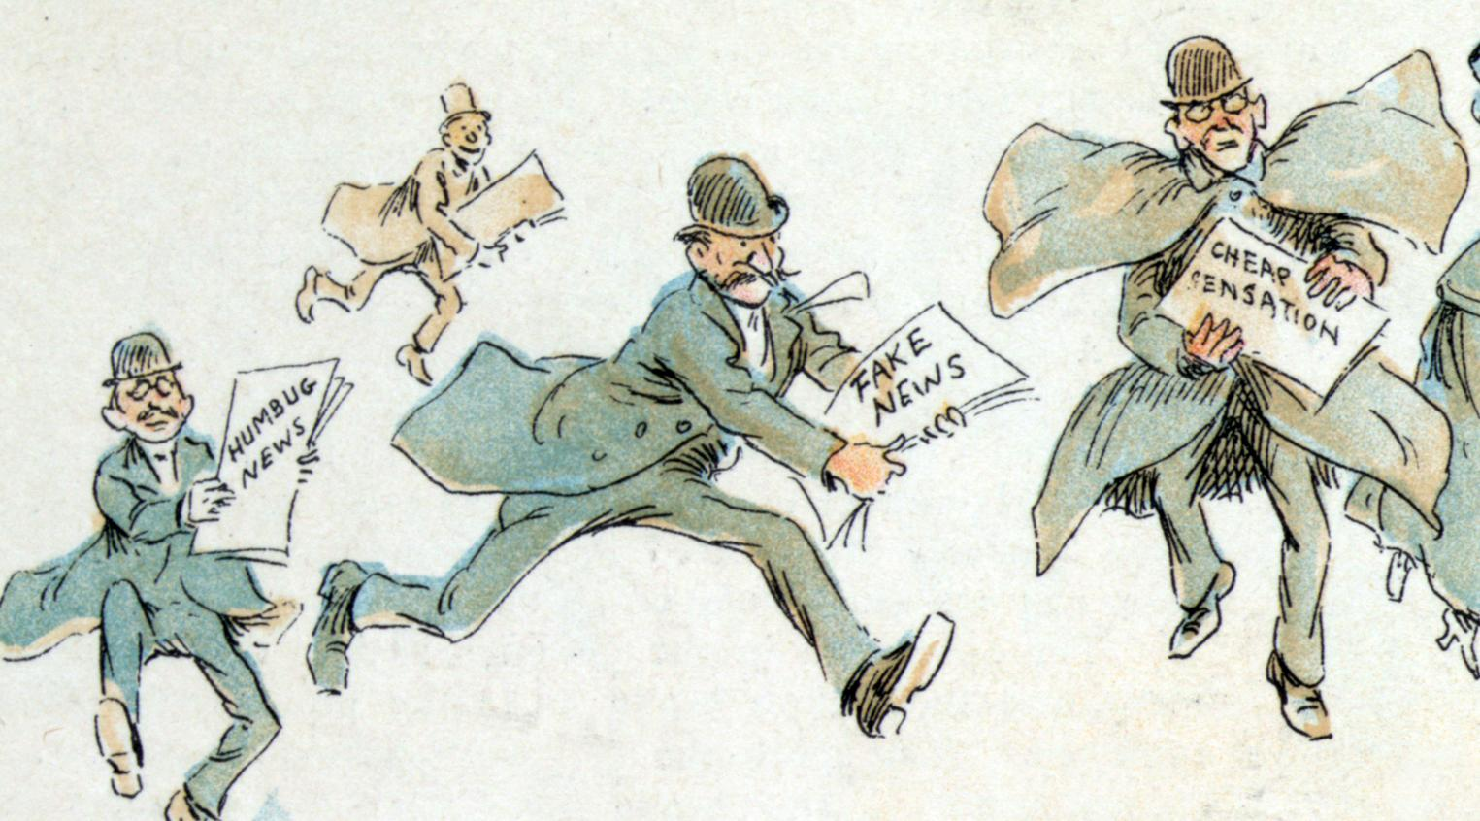
What if, like in banking and retail, blockchain could build greater trust in digital media?
Source

Slide 11
Cryptocurrency is decentralized digital money. Bitcoin and Ethereum are popular cryptocurrencies, but according to CoinLore, there are more than 5,000 different cryptocurrencies in circulation.

Slide 12
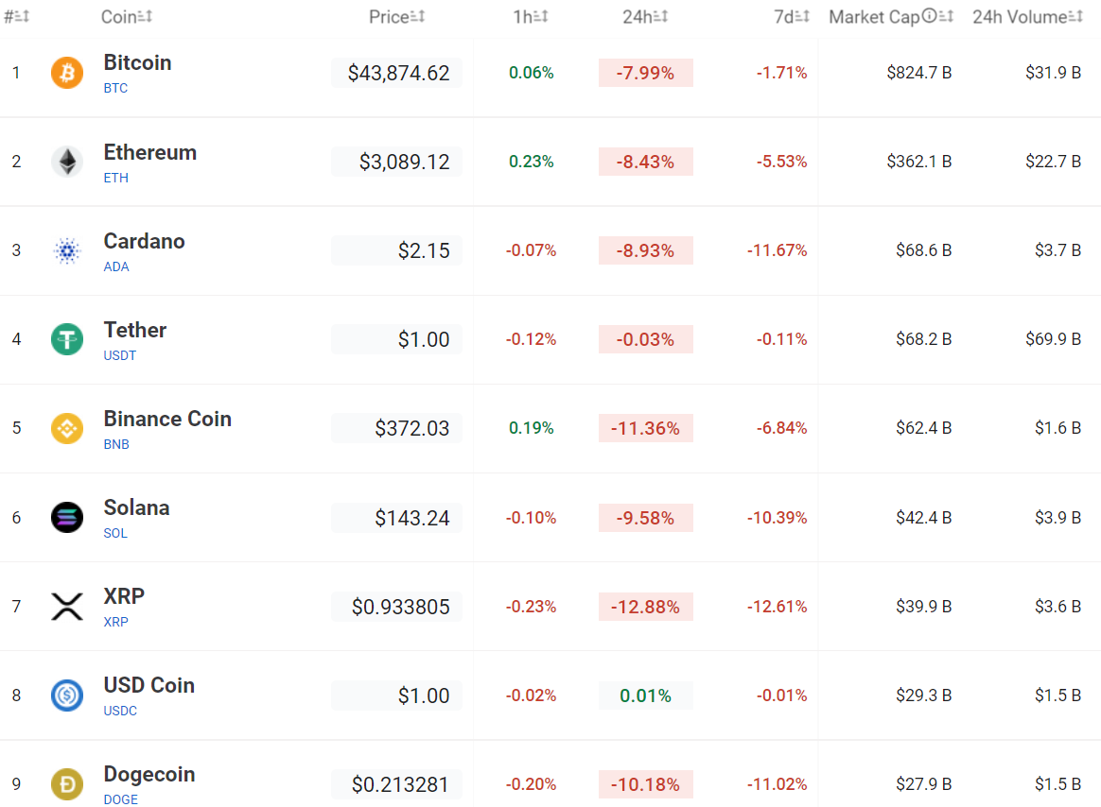
CoinLore

Slide 13
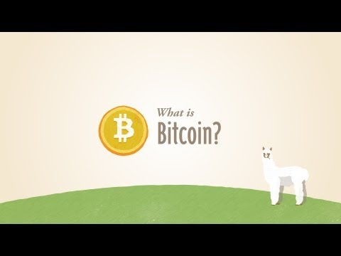
What is Bitcoin?

Slide 14
Getting Started with Bitcoin
Setup a Bitcoin wallet and connect it to your bank account:
How to find a good wallet
Blockchain Wallet
Bitcoin debit cards
You can buy bitcoins using a credit card or debit card via services like Indacoin, Coinbase, SpectroCoin etc.
The best way to earn bitcoins is to accept them as payment. Are there any libraries accepting cryptocurrencies for overdue fees?
Bitcoin mining can be a daunting task, but if you are interested in doing it check out NiceHash QuickMiner (NVIDIA graphics card required)
Bitcoin Merchant Directories
Airbitz
Open Bazaar
Coinmap
Are any libraries using services like BitGive to accept donations? The Internet Archive, King County Library System Foundation, and others are accepting cryptocurrency donations.
Source

Slide 15
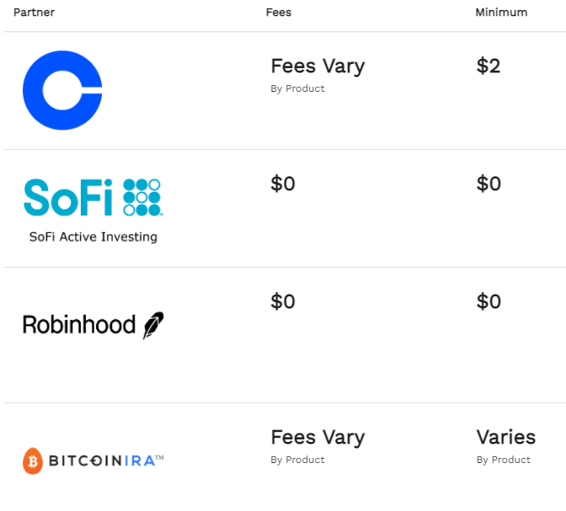
Pay Attention to Fees

Slide 16
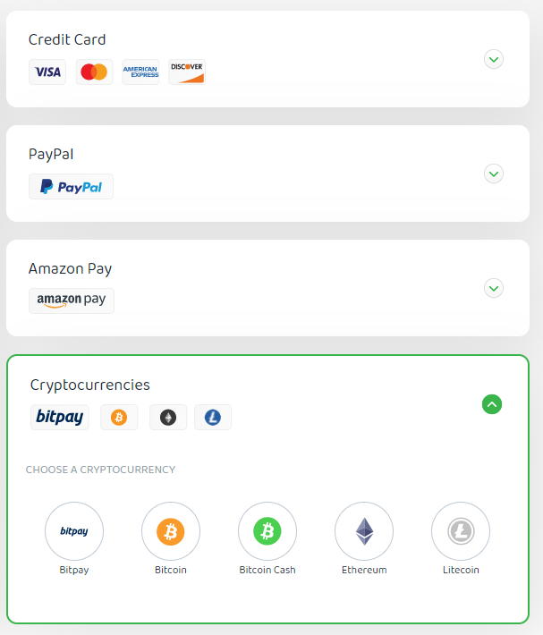
Accepting Cryptocurrencies

Slide 17
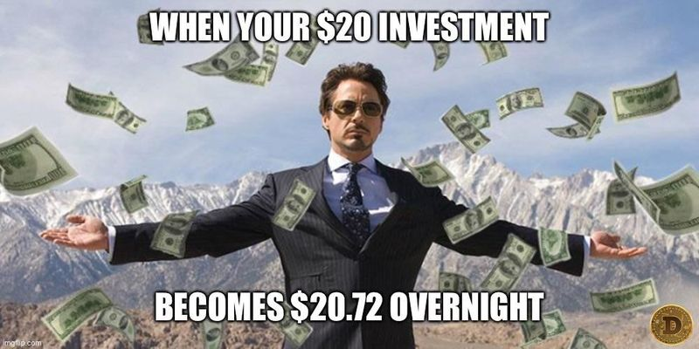

Slide 18
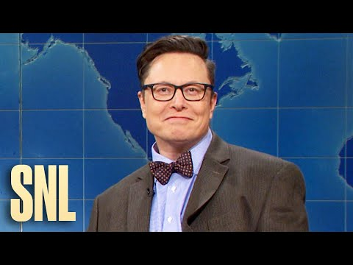
So, what is Dogecoin?

Slide 19
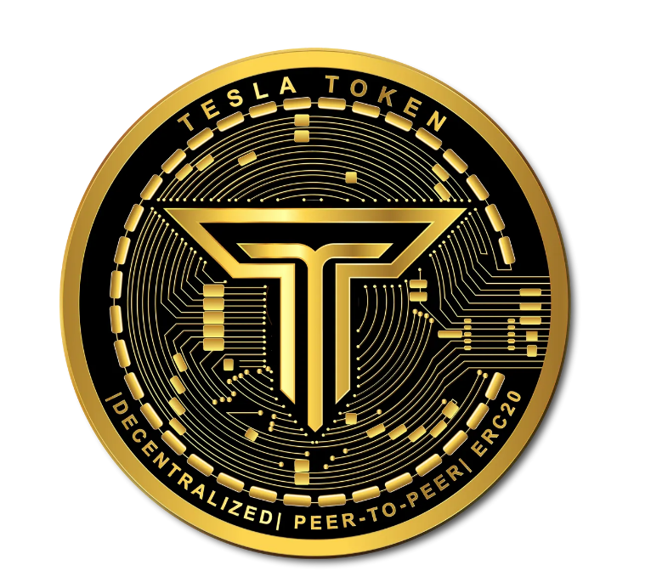

Slide 20
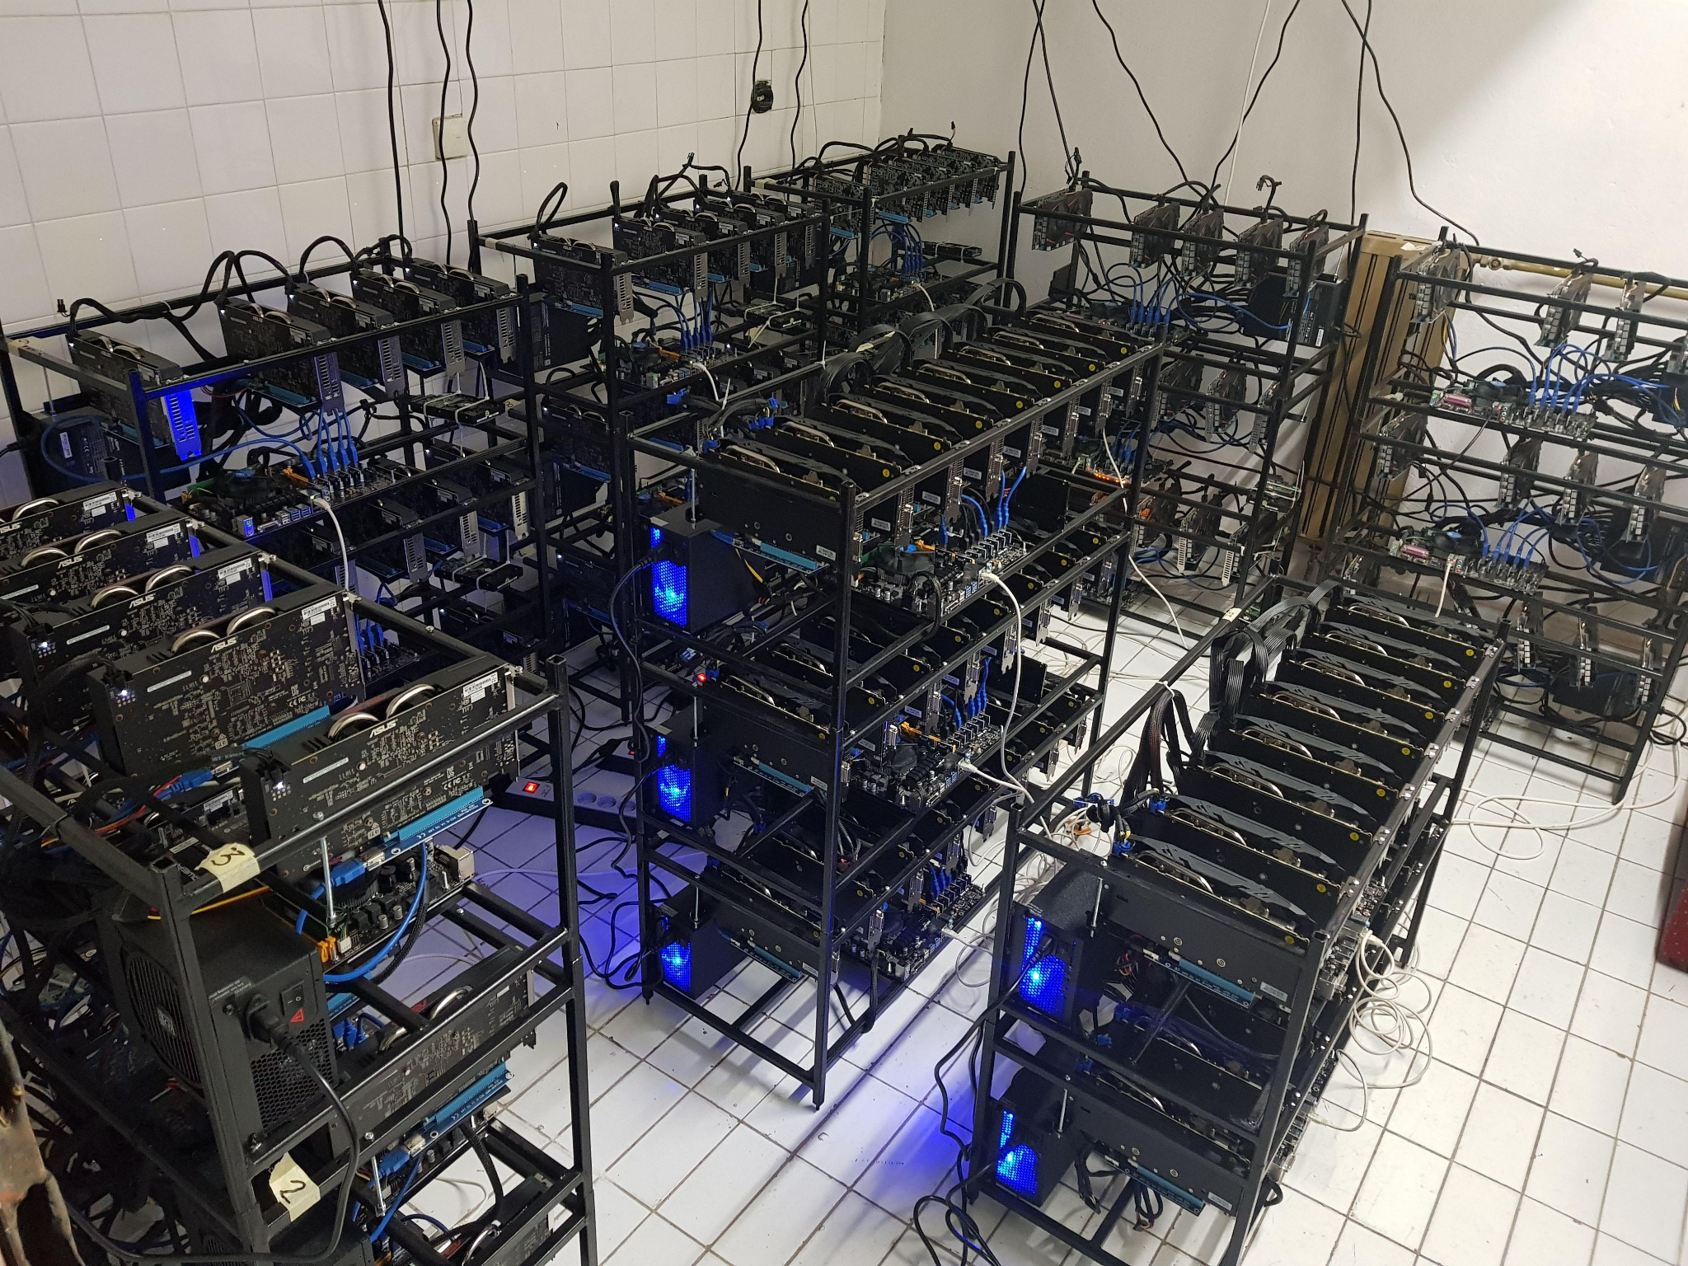
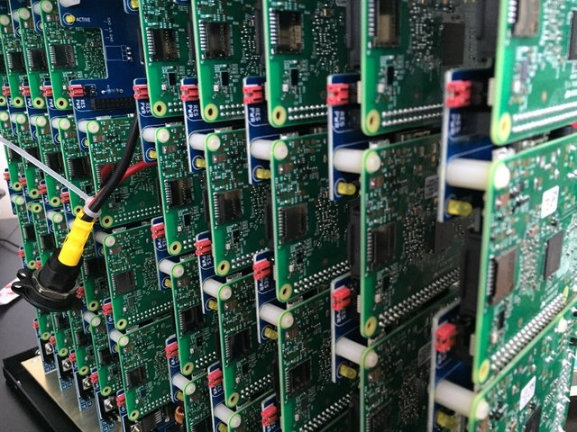
Ethereum Mining Farm
Mining Setups
40 Raspberry Pi units

Slide 21
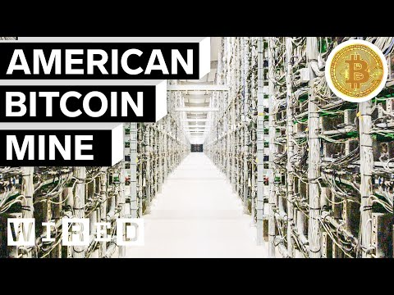
Inside the Largest Bitcoin Mine in the U.S.

Slide 22
Environmental Issues and Possible Solutions
If Bitcoin were a country, it would rank in the top 30 worldwide for energy use. In fact, electricity costs eat into estimated 28% of Bitcoin mining profitability each year according to Digiconomist.
Bitcoin’s decentralized structure drives its huge carbon emissions footprint because specialized computers (rigs) are consuming huge amounts of computational/electrical energy to be the first to solve math puzzles (cryptography) so they can get their reward.
Switch to Renewable Energy: ca. 39% of proof-of-work mining is performed using renewable energy. Genesis Mining in Iceland is using only renewable energy sources. We need more companies like this!
Transition to proof-of-stake systems (PoS), which do not require the same work to solve complex puzzles. Ethereum, the blockchain system powering Ether and most NFTs, is planning to transition to a PoS system to reduce the energy consumption.
Introduce Carbon Credits or other fees to offer an incentive for a company to produce less than its allotment or penalize those that go over.
Source

Slide 23
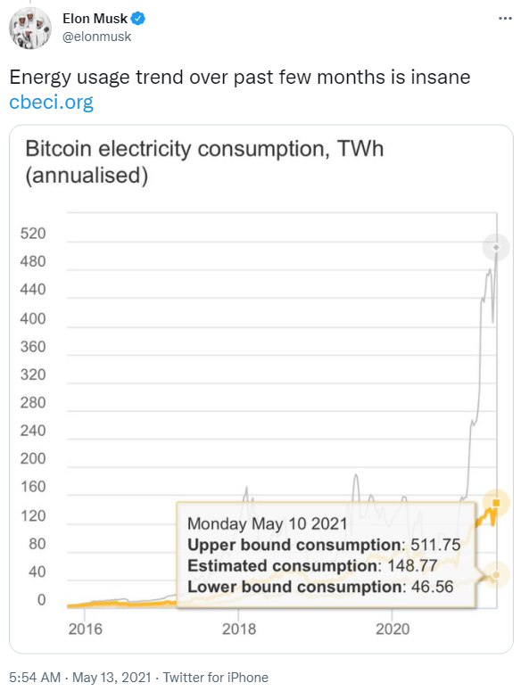
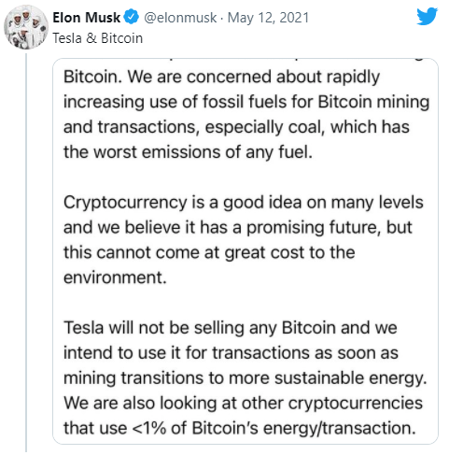
Environmental Issues
Source

Slide 24
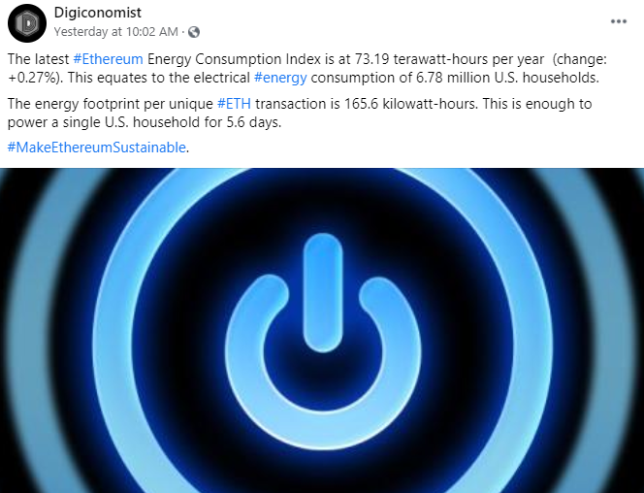
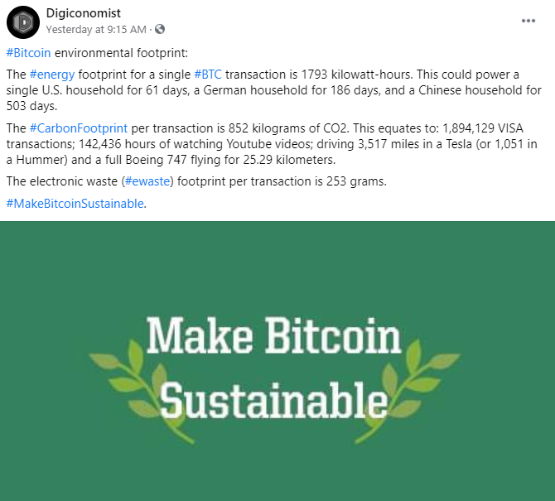
Environmental Issues
https://digiconomist.net

Slide 25
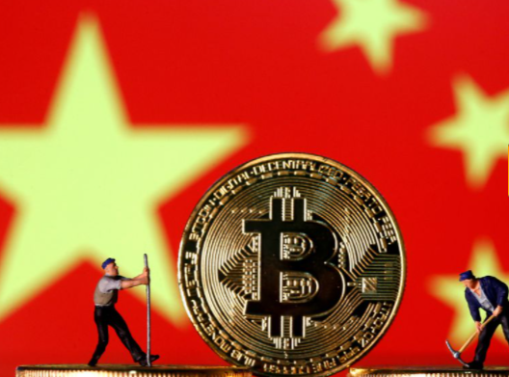
Cryptocurrency exchanges scramble to drop Chinese users after Beijing's ban
Source

Slide 26
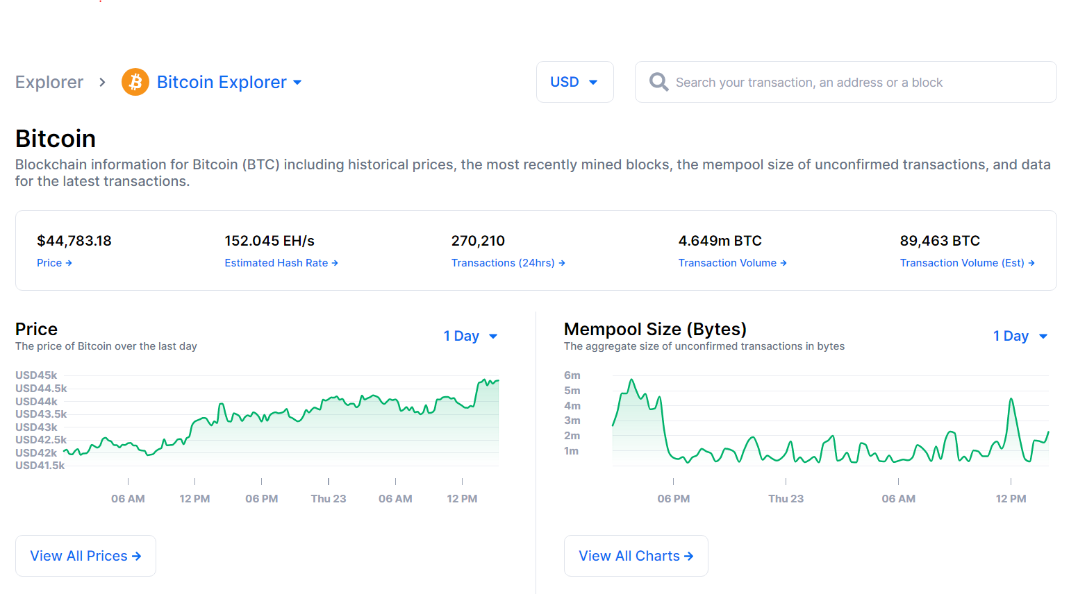
How can I look up a transaction on the blockchain?
https://www.blockchain.com/explorer

Slide 27
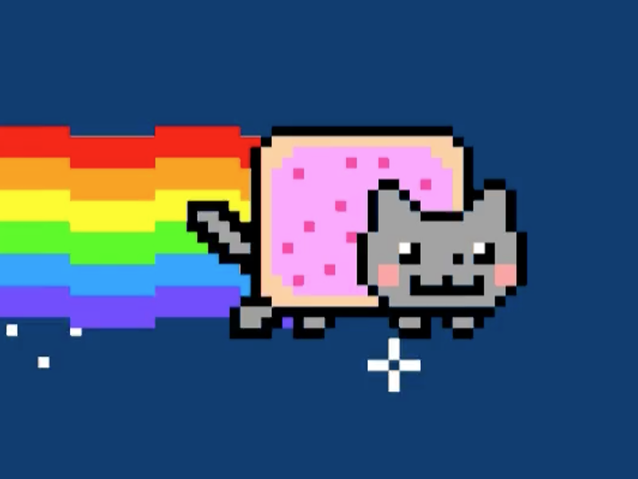
Blockchain and NFTs are turning gamers into investors!
Source

Slide 28
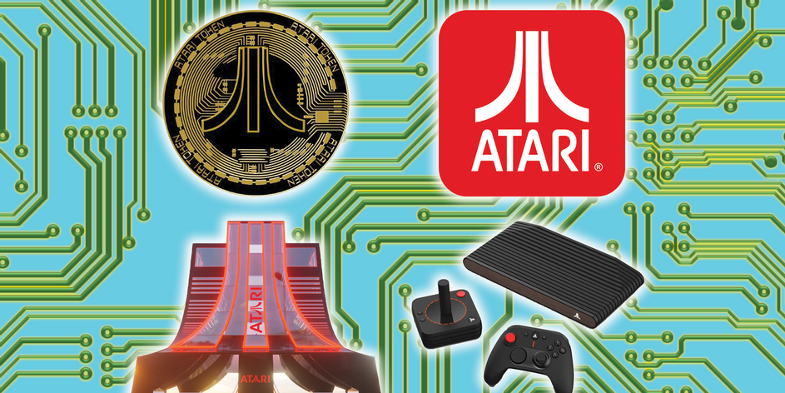
Atari Announces a New Blockchain Bureau to Explore Crypto and More
Source

Slide 29
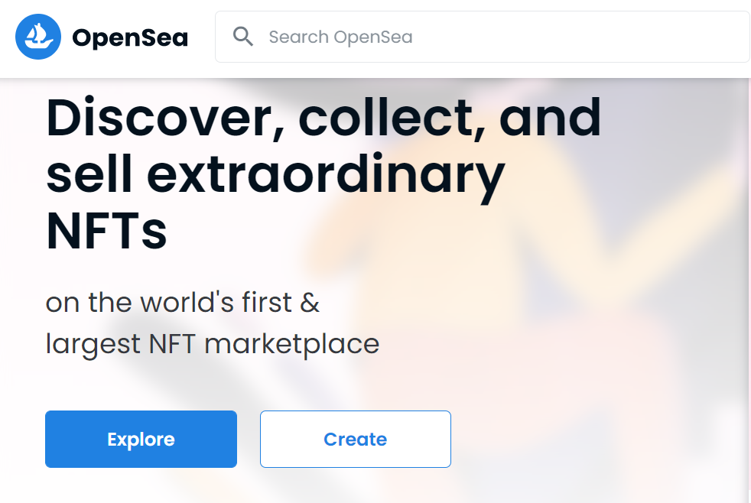
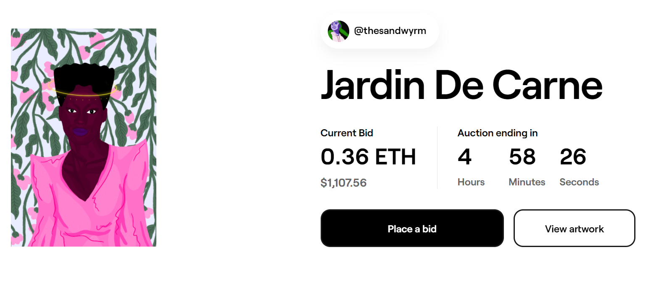
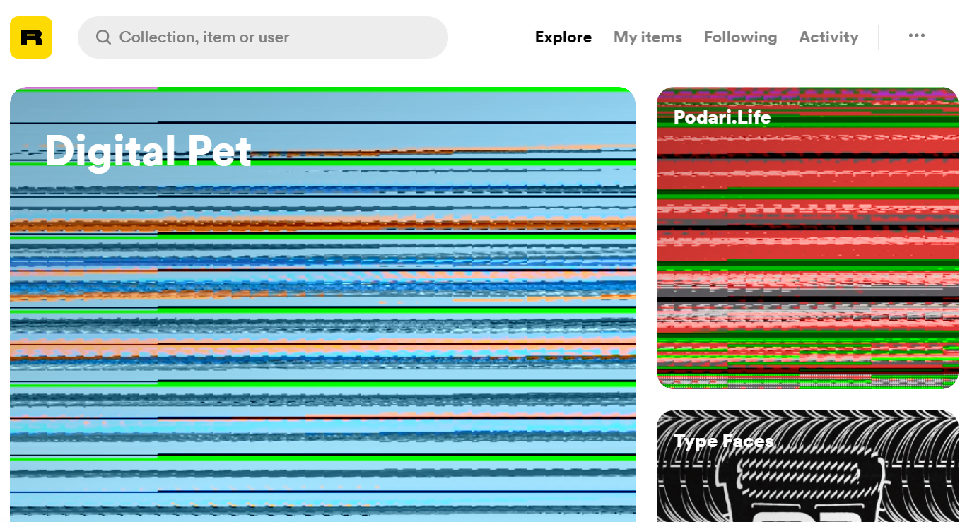
OpenSea
Acquiring NFTs
Foundation
Rarible

Slide 30
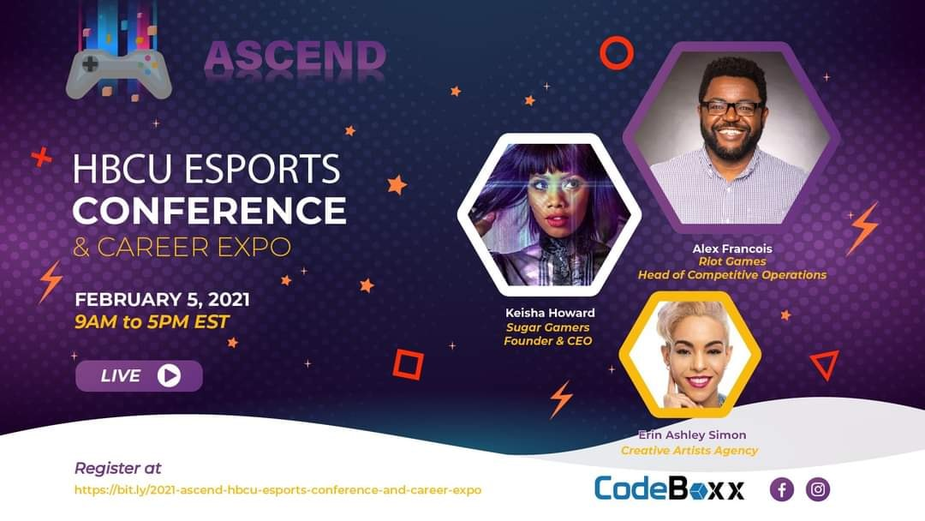
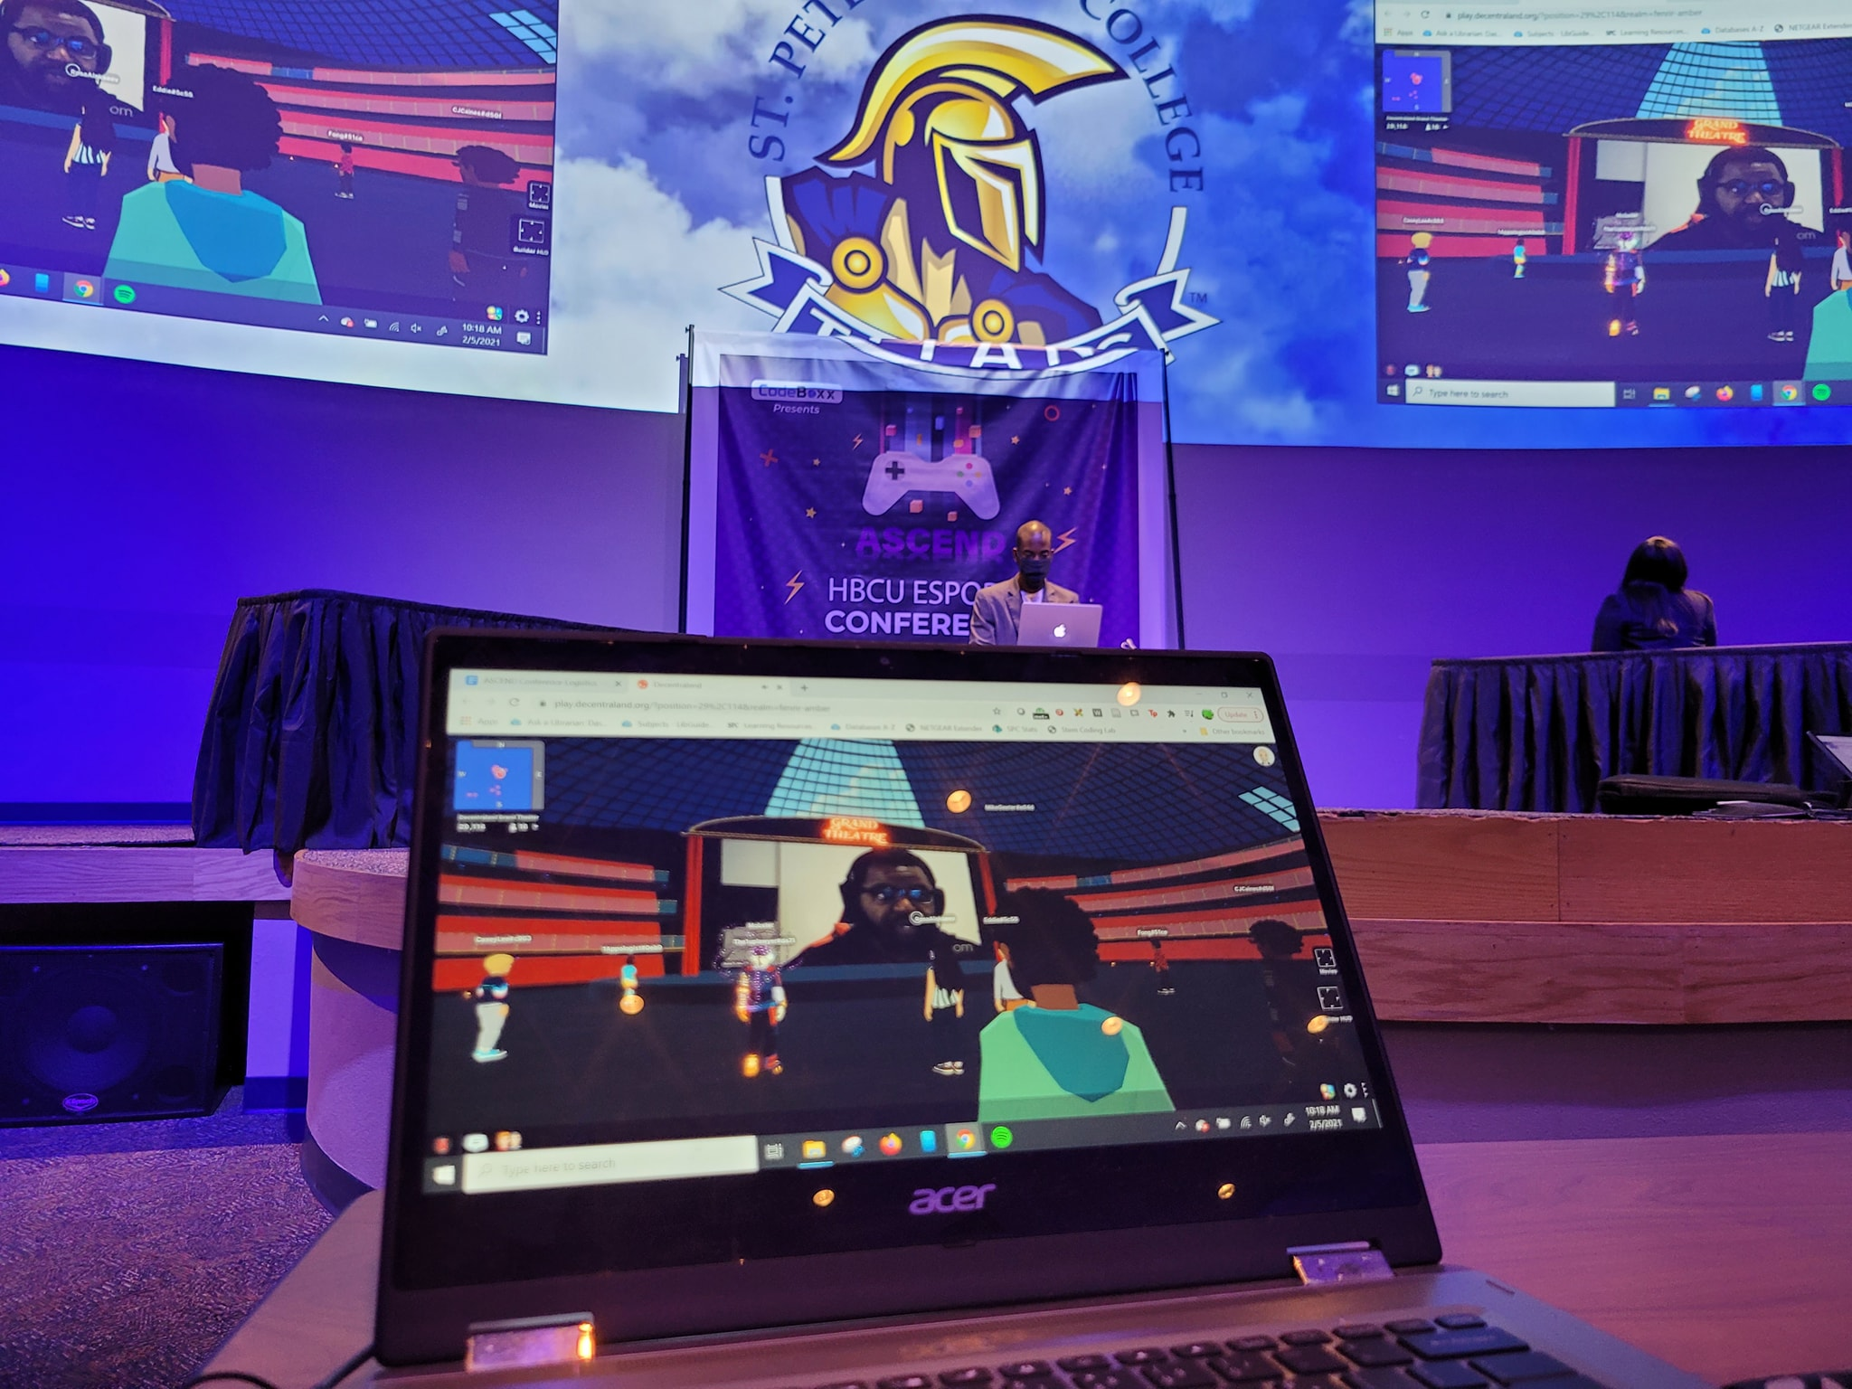
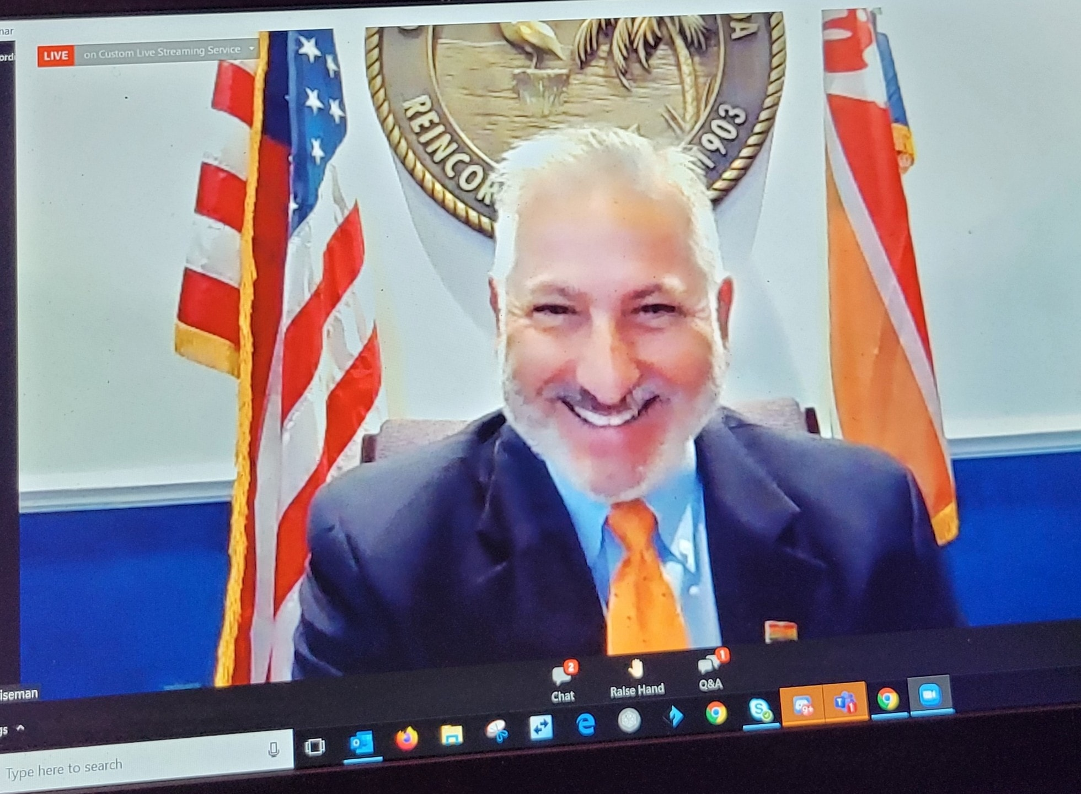
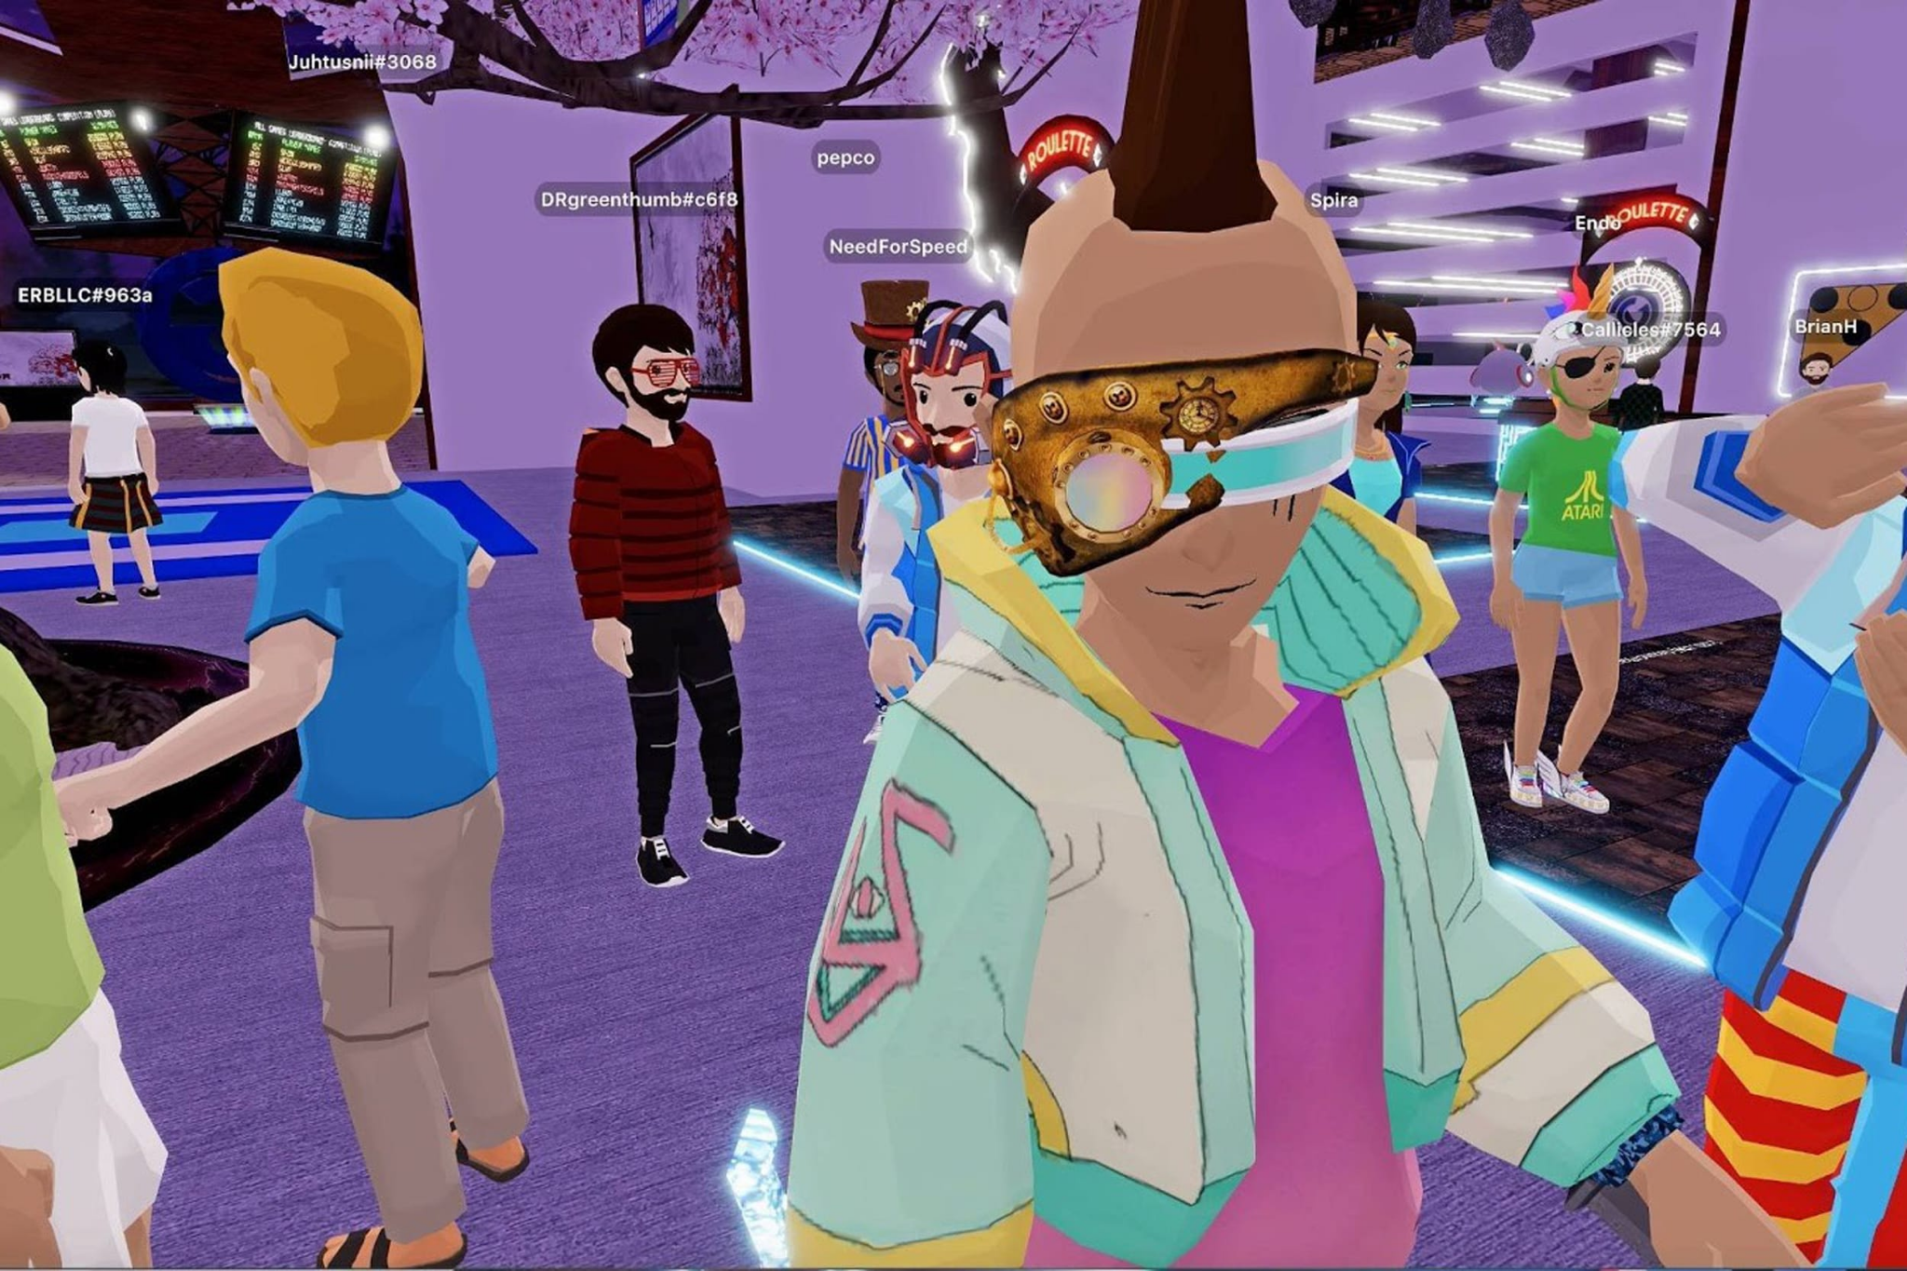
MetArena organized the 2021 ASCEND HBCU (Historically Black Colleges and Universities) Esports Conference and Career Expo, the first-ever virtual conference of this type.
More info

Slide 31
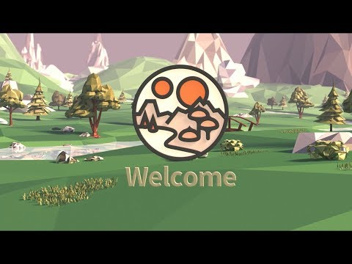
Decentraland
Learn more at https://docs.decentraland.org/
.io

Slide 32
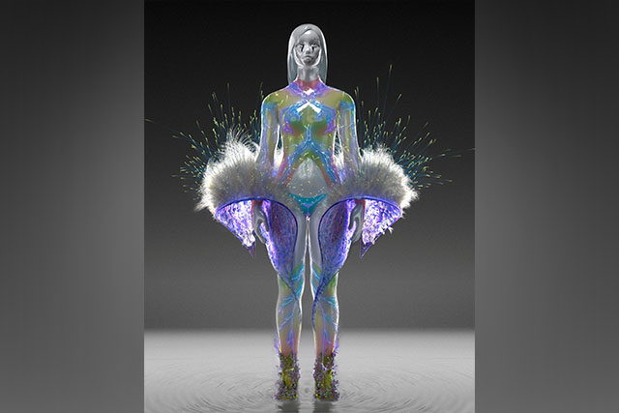
Crypto Fashion
Source

Slide 33
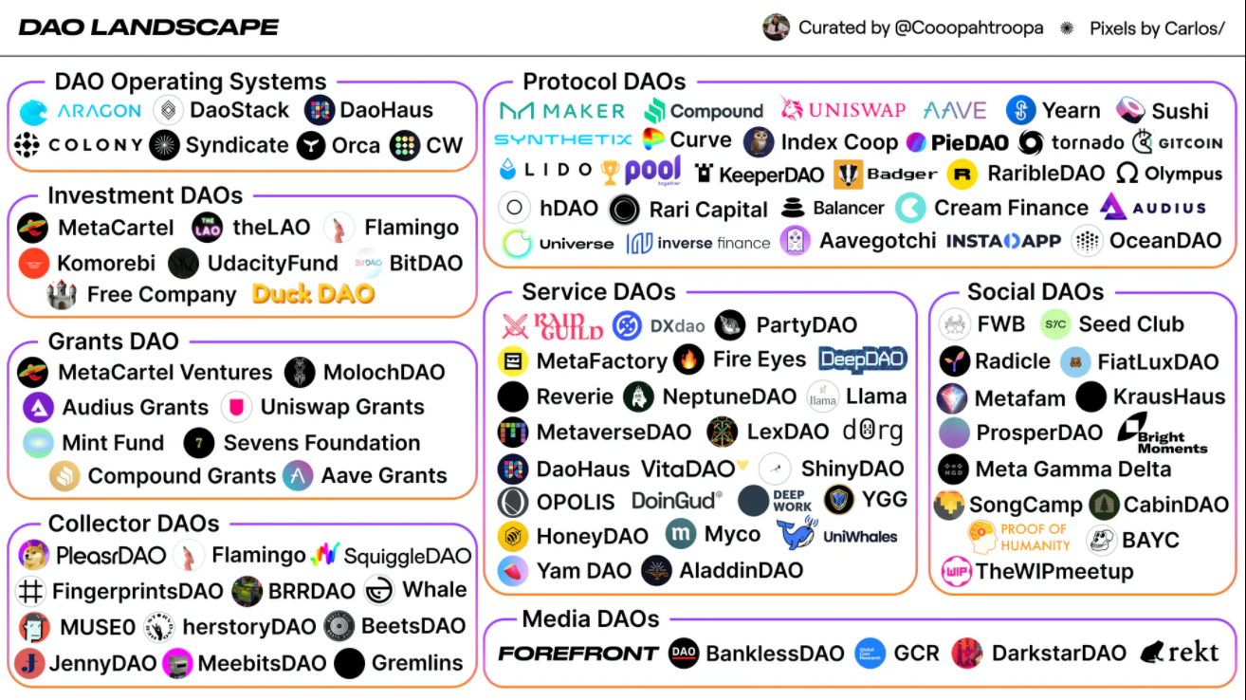
What is a DAO?
Source

Slide 34
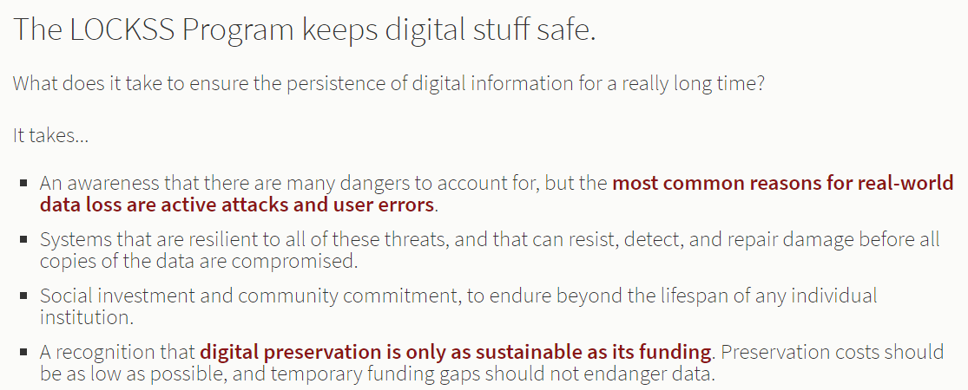
Source

Slide 35
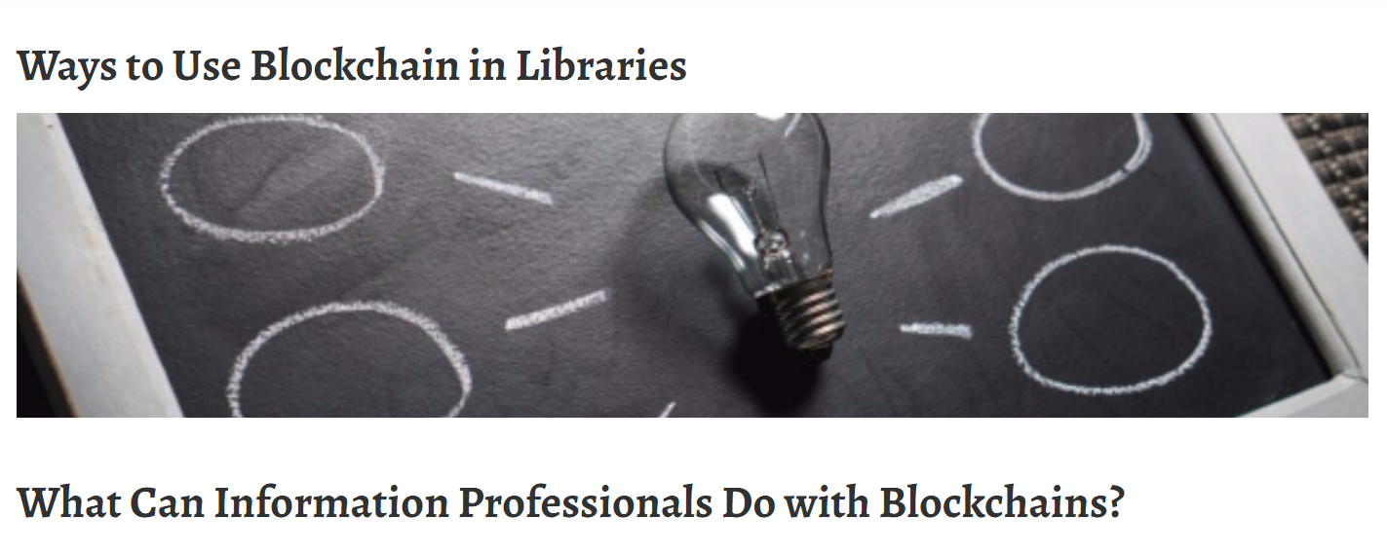
Build an Enhanced Metadata System for Libraries, Data Centers
Protect Digital First Sale Rights
Host Digital Peer-To-Peer Sharing
Ways Public Libraries Contribute to City Service
Give Badges for Skills Training
Source

Slide 36
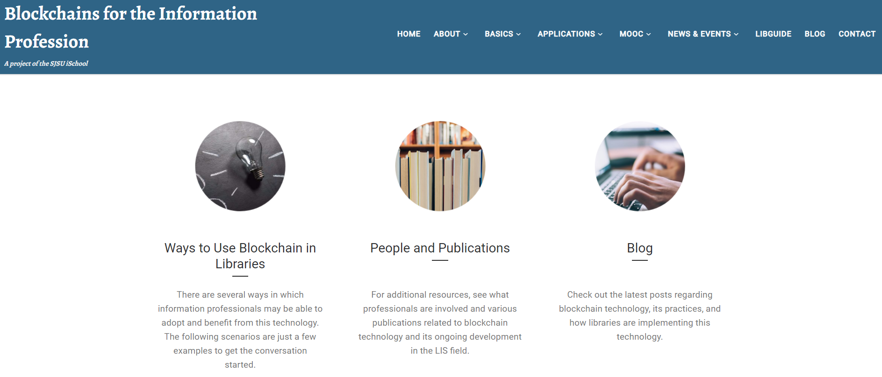
https://ischoolblogs.sjsu.edu/blockchains

Slide 37
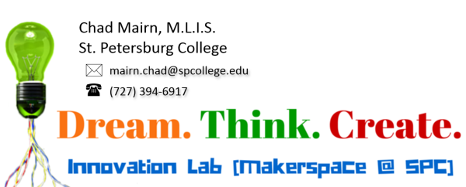
Contact me!

Slide 38
Supplemental Slides

Slide 39
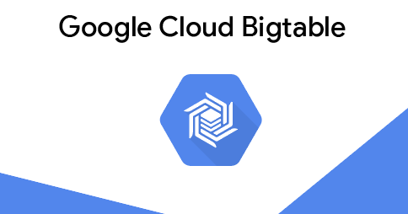
Bigtable is the database that runs Google's Internet search, Google Maps, YouTube, Gmail, and many other services.
https://cloud.google.com/bigtable

